Slide 1
Object Oriented Programming
Created by JL

Slide 2




Impossible to access

Slide 3



Setter
.setGold()
.setMagnaCarta()
.setPrincess()

Slide 4
Setter
.getGold()
.getMagnaCarta()
.getPrincess()
Getter

Slide 5

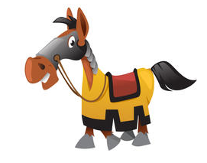


Setter
Method
.callTheCalvary()
.bringHorse()
.bringShield()
.bringMoreWeapon()
Getter

Slide 6
Setter
Method
Getter

Slide 7

Encapsulation
+
Public
Methods
-
Private
Variables

Slide 8
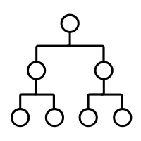
Inheritance
Vehicle → Car, Train, Ship
Knife → Swiss knife, kitchen knife,
butcher knife

Slide 9
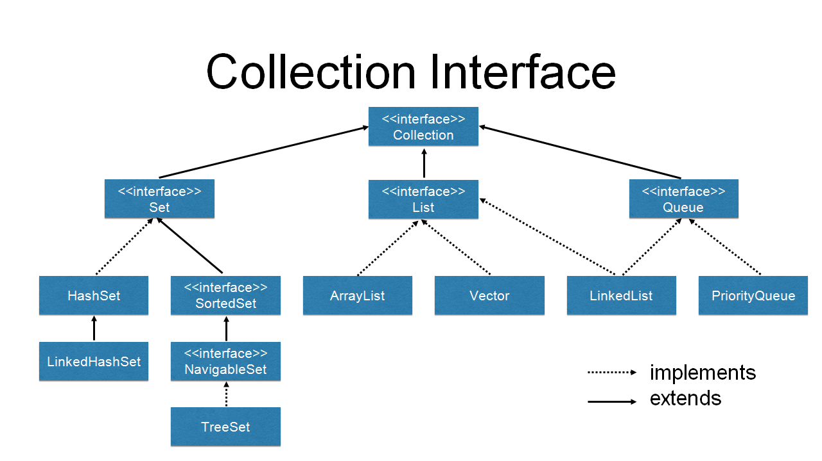
Inheritance

Slide 10
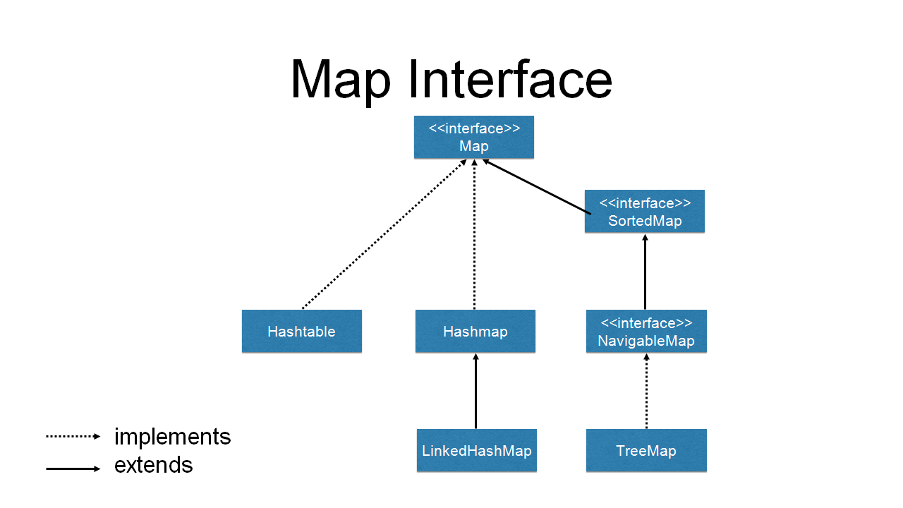
Inheritance

Slide 11
Composition
Vehicle has a:
Engine Oil
Gas
Mileage
Windows
Doors
Windshield Wipers
Hood
Trunk

